Slide 1

Vectorized Motion Positioning Component
Paweł Jerzyna, Piotr Grzyb, Marcin Dworak
Advanced Vision Systems | June 2026

Slide 2

Problem overview
Decoupled Navigation For Drones
Global Positioning Component (GPC): Absolute reference used to correct the trajectory with low frequency.
Motion Positioning Component (MPC): High-frequency relative odometry tracking frame-to-frame local transformations.
Our Goal: Maintain trajectory estimation during GPC dropouts or signal jams in GNSS-denied zones through implementation of MPC (visual odometry).
[1]

Slide 3
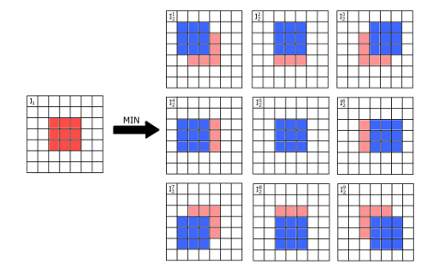

MPC solution in source paper - KLT
Addressing KLT Limitations
Traditional Kanade-Lucas-Tomasi (KLT) estimates movement by shifting a small window around a point to match its pixel brightness from the previous frame .
Critical Vulnerabilities: • Susceptibility to sudden illumination shifts. • Lack of analytical transparency. • High sensitivity to perspective distortions.
Our solution: A fully vectorized, feature-matching architecture.
[[2]

Slide 4
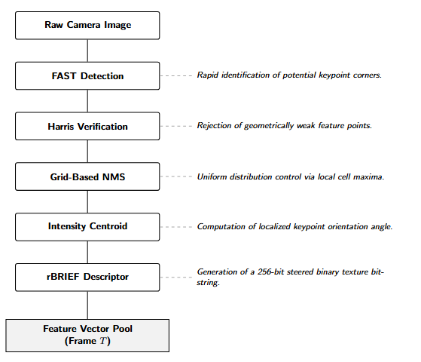
Stage 1 - Feature
point extraction
and description

Slide 5


Feature point detection
Dual-Stage Filtering
FAST Detection: High-speed pixel contrast analysis on a 16-pixel ring.
Vectorized Computation
Harris Corner Measure: Scoring keypoints via structural tensor response to ensure geometric invariance.
eliminated slow Python loops through native array broadcasting, enabling concurrent processing of thousands of visual features to maintain real-time navigation feedback.

Slide 6
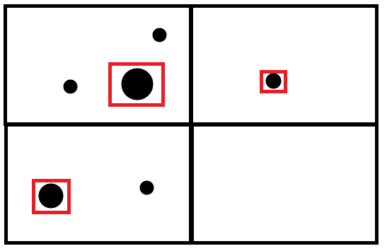


Grid-based NMS
Grid-Based Suppression
Traditional Non-Maximum Suppression (NMS) exhibits complexity.
Our system employs Grid Bucketing:
Image is partitioned into discrete pixel cells.
NumPy reduction selects only the max Harris score per cell.
Achieves linear complexity

Slide 7
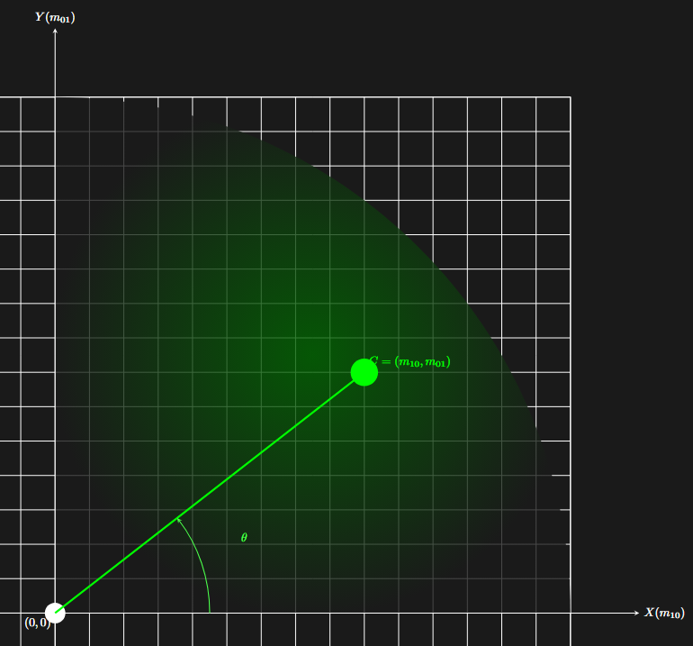



Rotational invariance
rBRIEF Descriptors
Intensity Centroid Steering: Local patch moments guide orientation alignment .
Centroid Calculation
Batched Transformation: The 256 pixel-test pairs are rotated simultaneously using (N, 2, 2) tensors.
Result: Compact 256-bit bitstrings stored as four 64 bit numbers.

Slide 8
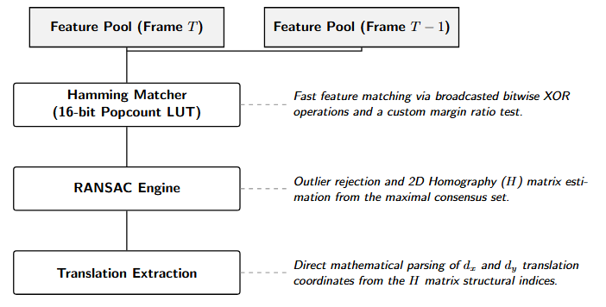
Stage 2 - Matching
and motion estimation

Slide 9
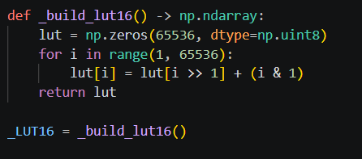
Optimizing Hamming
Distance for computational
efficiency
Optimized Hamming Distance
Traditional nested loops for distance calculation are the primary bottleneck in Python implementations. Our matcher bypasses this by implementing a 16-bit LUT, which is used to count the Hamming Distance by slicing the 256-bit descriptor into 16-bit segments.
Bitwise XOR operations across broadcasted array dimensions ensure real-time performance on standard CPUs.

Slide 10
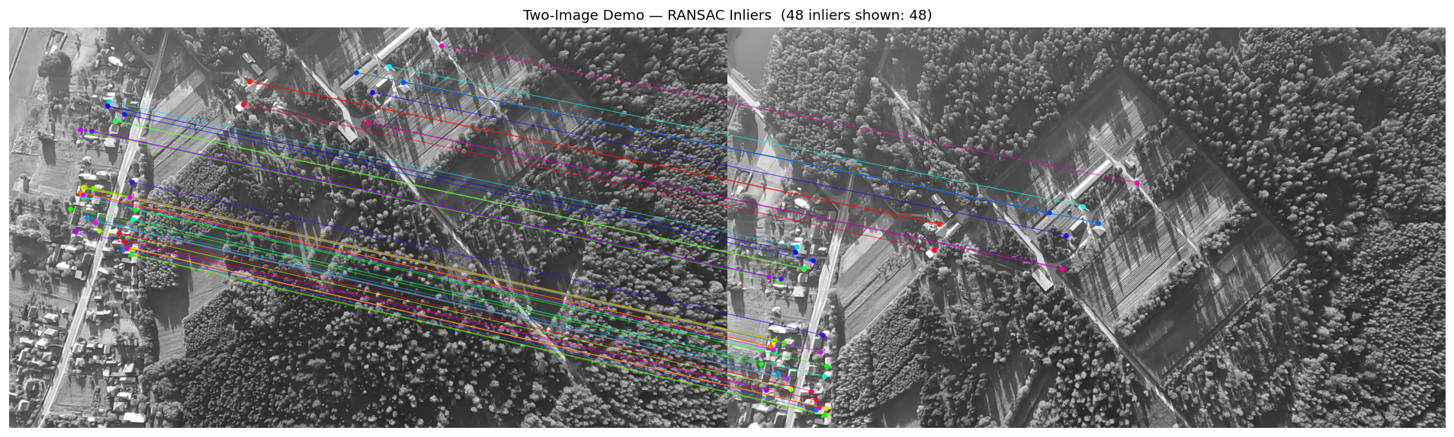
RANSAC filtration results

Slide 11
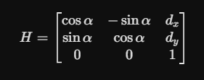
Movement estimation
RANSAC iteratively estimates the optimal 2D Homography (H) matrix by maximizing the number of geometrically verified inliers.
Estimated movement: frame-to-frame image displacement is directly extracted from the structural translation indices of the computed H matrix .

Slide 12
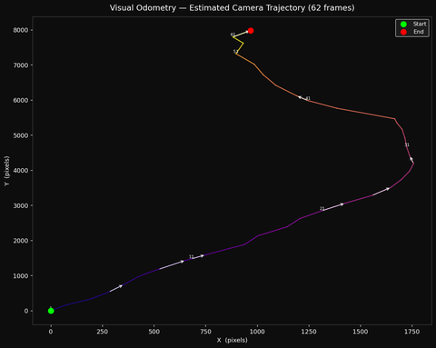
Estimated trajectory based on 62 frame snippet
Anomaly protection in the tracking system relies on a two-stage filtering pipeline that verifies raw translation vectors in real time. The algorithm analyzes spatial motion deviations between frames, utilizing a dynamic outlier rejection mechanism and hard mathematical constraints based on standard deviation. Any illogical or abrupt vectors caused by feature matching noise are automatically blocked, ensuring that only stabilized and safe displacement coordinates are fed into the control loop.

Slide 13
Image sources
[1]https://images.stockcake.com/public/4/0/8/4081f761-a5c0-4c0d-80dc-e4689a1a5b93_large/futuristic-drone-flight-stockcake.jp
[2] T. Kryjak, M. Wąsala, H. Szolc, P. Wzorek, K. Błachut, M. Daniłowicz, Advanced Vision Systems. AGH UST International Course, Fourth edition, revised and corrected, Embedded Vision Systems Group, Vision Systems Laboratory, WEAIIB, AGH University of Krakow, Krakow, February 2026

